Slide 1
Academic Reading & Writing
Unit 3: Dictionary Use in L2 Writing
Literature Reviews

Slide 2
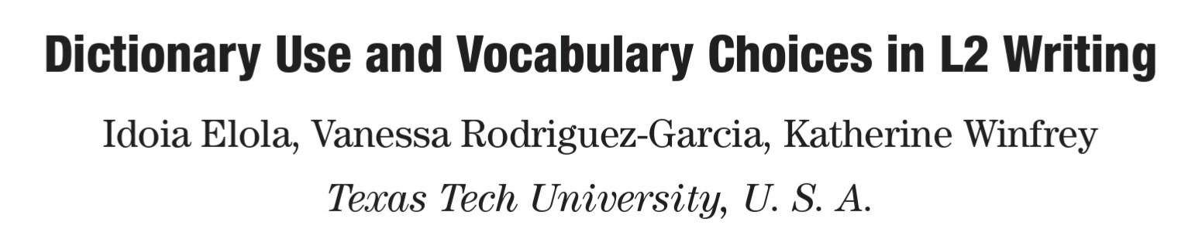
Last Week
We started Unit 3
We read the Literature Review for this paper to see vocabulary and how it was structured; today we’ll focus more on writing Literature Reviews

Slide 3
Quiz
We will begin this unit with a short vocabulary quiz
Some questions have more than one answer
I will post the link in the Wechat group
This will be online and multiple choice
You have 20 minutes

Slide 4
Literature Reviews & Citations

Slide 5
Types of Sources

Slide 6
Primary Sources
These are sources that contain raw, original, non-interpreted and unevaluated information
These are often published right away, things that are contemporary to the event being studied, or the first pieces of related information to something
A primary source might be a diary, newspaper, or letter written near or during a certain event, or the first study of a particular research question

Slide 7
Secondary sources
Sources that digest, analyze, evaluate and interpret the information contained within primary sources.
They tend to be argumentative, trying to understand or analyze the meaning or importance of something
These will come longer after the event or topic in question – often scholarly articles, literature reviews, and books

Slide 8
Tertiary Sources
These are sources that compile, analyze, and digest secondary sources
They tend to be factual, covering information without as much commentary
These are often the most recent, and include dictionaries, encyclopedias, annotated bibliographies and other reference books

Slide 9
Primary Sources:
Recording the information first
Secondary Sources:
Analyzing and Discussing the Recorded Information
Tertiary Sources:
Summarizing the Information So Far

Slide 10
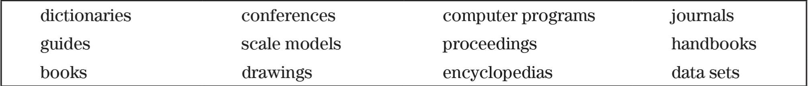
Categorize the following sources on p.98 and explain why:
Primary:
Secondary:
Tertiary:

Slide 11
Writing Focus – Literature Review
(P. 91)

Slide 12
Purpose of a Literature Review
A literature review summarizes published scholarly information in a particular subject, or area of research within a certain time period.
Most of the time, it is an essential chapter in an academic work, but it can also be a research project itself
It should not just be a list – there should be themes and structure to show why the references inform the research project or research topic

Slide 13
Function of a Literature Review
You want to use the Literature Review to:
Convey that you really know and understand what others in your field have accomplished
Provide important background information to your readers
Set the stage for you to demonstrate what your research contribution is going to be to the larger field

Slide 14
How to Write a Literature Review
This can be a very time-consuming parts of writing a research paper
Having a general strategy at the beginning can save you time later on – particularly recording information at the beginning you need to reference at the end

Slide 15
Step
Step 1: Problem formulation
Step 2: Literature search
Step 3: Note-taking
Step 4: Literature review writing

Slide 16
Step 1: Problem Formulation
Before starting any research, you want to know what you are studying
The narrower and more defined your problem is, the fewer and more relevant research sources you can find
This is the first step to the research project as a whole

Slide 17
Step 2: Literature Source
Use your resources to look for literature relevant to your research question/research problem
This could be an in-person library, or online databases the library subscribes to (such as LexisNexis and JSTOR)
Make sure to record the full bibliographical information of any work you decide to use when you first read it – this will save you time later!
Mark the source as Primary, Secondary, or Tertiary

Slide 18
Step 3: Note-Taking
Now that you have selected works useful for your project, re-read them critically
You want to look for helpful tips, next steps, and implications, but also limitations
Take notes on key issues or anything else relevant to you, and record their location (page numbers)

Slide 19
Step 4: Writing the Review
Start with an introductory paragraph and establish your research topic
Synthesize the body text of literature and divide it into sections and subsections if necessary
Organize the literature according to chronology, theories, methods, findings, authors, etc.
Begin each major section with a clear and explicit topic statement and end them with a transition
Present the literature by quoting, summarizing and paraphrasing

Slide 20
Step 4: Writing the Review
End with a conclusion paragraph
Summarize previous research: how does the previous research help you?
Shed lights on the gaps of previous research and create a space for your research argument: how does your project help the overall field?

Slide 21
Step | Action
Step 1: Problem formulation | Establish your research topic and its component issues
Step 2: Literature search | Go to the library or go on the internet Find materials relevant to the subject being explored Keep a bibliographical trail Mark the sources as primary, secondary and tertiary
Step 3: Note-taking | Critically read each source Take notes on the key issues identified earlier
Step 4: Literature review writing | Introduction: Research Problem Synthesis (Sections if necessary) End Paragraph: Summary and Create A Space

Slide 22
Literature Review Assignment
You will have four weeks to write a literature review section (as we talked about, general to specific) on a topic related to teaching, student life, or post-secondary education/universities
You want to include at least ten sources
Your topic should be narrow enough to not be a whole field of research, but broad enough to have at least ten previous papers
Think of the papers from the textbook so far – Student & Staff perception of plagiarism and dictionary strategies for 2nd language learning
You will have four weeks to work on this

Slide 23
Assignment Format
Use the existing papers in the book as a guide:
Initial overview of the topic or research question – papers with broad conclusions
Specific research in the topic
Write about gaps in research that can be filled (as if you were writing the full paper, or next steps for other researchers)
Cite using APA format for in-text sources & reference list at the back

Slide 24
November Assignment FAQ
Some more details for the Literature Review Assignment:
No word count limit, but don’t go over 5 pages
Type in a standard font, 12-point size
You can use sources in other languages, but all cited conclusions and information must be paraphrased in English, as is the citation
There must be a reference list in the back using proper APA style, as well as the in-text citations (use the textbook as a guide)

Slide 25
Citation and Citation Styles

Slide 26
Citations
Whenever you use concepts, definitions, or ideas from some other source, you must acknowledge the reader
This way, you do not take credit for someone else’s work and others can verify that you are correct

Slide 27
When to use citations
Use a citation every time you write something that you did not think of, including:
Quoting another source
Paraphrasing or summarizing another source
Using an idea expressed by someone else first
Make a reference to some other work
Any time someone else’s work is important for you
When you state any fact, you must cite a source to back it up, except:
You don’t need to cite works for common knowledge (e.g. the sky is blue)

Slide 28
Main Styles
APA (American Psychological Association)
MLA (Modern Language Association)
Chicago

Slide 29
APA
Most common in science and social science, business, and nursing
General guidelines:
1 inch margins
Page header at the top of every page with the title of your paper
Use common fonts and font sizes

Slide 30
APA in text citations
In text citations use the parenthetical author-date method
Author’s name first, followed by the year of publication, in parenthesese ()
(Smith, 2009)
No direct quotes necessary, but direct quotes need page numbers (p. for one page and pp. for multiple pages)
(Smith, 2009, p. 100) or (Smith, 2009, pp. 100-200)
If located at the end of a phrase or sentence, the citation goes before punctuation (so the period or comma is after the last parenthesis, like this).

Slide 31
APA in text citations
If you are quoting directly from the source, you can introduce the quotation with a signal phrase:
According to Smith (2009), “….” (p. 100)
Smith (2009) found “…” (p. 100)
Otherwise page numbers are included in the citation
She stated “….” (Smith, 2009, p. 100).
When referencing existing research, APA requires signal phrases to use Past or Present Perfect tense (found/ has found)

Slide 32
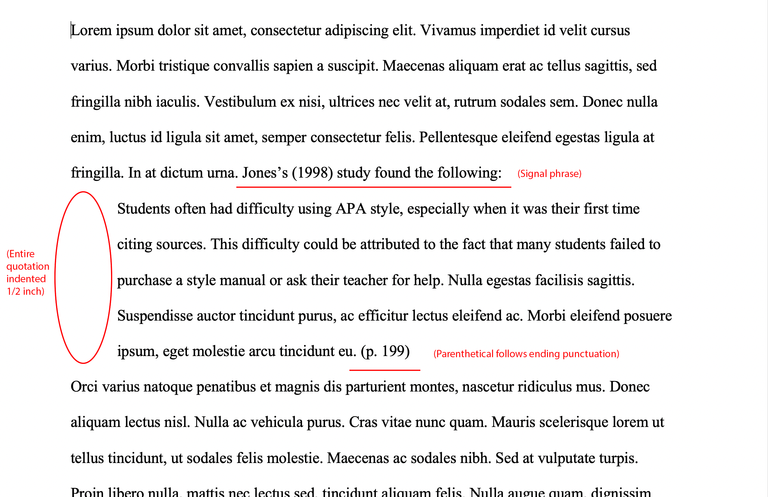
APA in text citations
Long quotations (>40 words) are indented on a separate paragraph with ½ inch margins
Summarizing or paraphrasing don’t need page numbers, but you can include it if you like

Slide 33
APA in text citations
For two authors, include both:
(Smith & Doe, 2009)
For three or more authors, include just the first author followed by “et al”:
(Smith et al., 2009)
Smith et al. (2009) stated “….”
Unless the authors have multiple publications of the same year
Smith, Doe, and Jones (2009) → (Smith, Doe, et al., 2009)
Smith, Liu, and Wang (2009) → (Smith, Liu, et al., 2009)

Slide 34
APA in text citations
For two authors that found the same thing, include both citations
(Smith, 2009; Doe, 2010)
If both are from the same author, cite them in order of year
(Smith, 2009, 2010, 2011)
If two citations are from the same author and in the same year, use a and b
(Smith, 2009a)

Slide 35
APA in text citations
Try to avoid indirect sources
If it’s unavoidable, name the original source and use only the secondary source in your reference list
Johnson (2000) states that …. (as cited in Smith, 2009)
(Johnson, 2000, as cited in Smith, 2009)

Slide 36
APA in text citations
If a source does not have an idenntified author, use the title in a signal phrase and include the year in parentheses, or use the first few words of the title
Book and reports are italicized while articles and chapters are in quotation marks “”
A similar study was done of students learning to format research papers (“Using APA,” 2001).

Slide 37
APA in text citations
If the source is a public agency or organization like a government department, use the organization title in a signal phrase
According to the American Psychological Association (2000),
If the organization has a well-known acronym, use the full name for the first reference and the acronym in future references
First citation: (Mothers Against Drunk Driving [MADD], 2000)
Second citation: (MADD, 2000)

Slide 38
APA in text citations
Mentions of people or places need capital letters (ex: D. Smith)
References to the title of a source need capitals for main words (Longer than 4 letters):
Permanence and Change
All nouns, verbs, pronouns, adverbs, and adjectives must be capitalized in titles:
There Is Nothing Left to Lose

Slide 39
APA reference list
Basic rules:
Last names first; first and middle names written as initials
Write up to 20 authors. If there are >21 authors, use “…” after 19th author and write the final author in the list
The list should be in alphabetical order of author last names. For the same name, organize by date (earliest to latest)

Slide 40
APA reference list
Basic rules:
Title of article follows author
Journal name follows article
Capitalize all major words in journal names

Slide 41
APA reference list
Basic form:
Author, A. A., Author, B. B., & Author, C. C. (Year). Title of article. Title of Periodical, volume number(issue number), pages. https://doi.org/xx.xxx/yyyy
Magazines and newspaper titles can replace the periodical title

Slide 42
APA reference list
Single author:
Smith, J. (2009). Citing references in research. Journal of Research, 1(1), 100-200.
Two authors:
Smith, J. & Doe, J. (2009). Citing references in research. Journal of Research, 1(1), 100-200.
Group author:
Merriam-Webster. (2008). Braggadocio. In Merriam-Webster’s Advanced Learner’s English Dictionary. Merriam-Webster.

Slide 43
APA reference list
If the author appears in two references, list the single reference first
For more than one single reference, organize by date
Organize the references based on alphabetical order of second author
Smith, J. (2009). Citing references. Journal of Research, 1, 100-200. Smith, J. (2010). Citing references again. Journal of Research, 1, 100-200. Smith, J. & Johnson, R. (2007). Citing more references. Journal of Research, 1, 100-200. Smith, J. & Wang, R. (2007). Citing so many references. Journal of Research, 1, 100-200.

Slide 44
APA reference list
Books:
Author, A. A. (Year of publication). Title of work: Capital letter also for subtitle. Publisher Name. DOI (if available)
Smith, J. (2009). Citing references: All the rules. Yale University Press.
Edited book:
Author, A. A. (Year of publication). Title of work: Capital letter also for subtitle (E. Editor, Ed.). Publisher. DOI (if available)
Smith, J. (2009). Citing references: All the rules. (J. Doe, Ed.). Yale University Press.

Slide 45
APA Format for Foreign Language Sources
Author(s) - last name, initials. (Year). Article title in original language [English translation of article title]. Journal name - italicised, volume - italicised(Issue - if available. Not italicised), Page(s). DOI or Web address - if available
For sources that use other alphabets, transliterate (in Chinese, Pinyin) the title, as we are not to use other alphabets in APA style
Names should still be last name, initials

Slide 46
Use normal format, but add translated title after transliterated one
Najm, Y. (1966). Al-qissah fi al-adab Al-Arabi al-hadith [The novel in modern Arabic literature]. Dar Al-Thaqafah.
Ministry of Foreign Affairs. (1997, June 12). Peru jiken chosa iinkai no hokoku ni tsuite no Ikeda Gaimu Daijin no kishakaiken [Press interview with Foreign Minister Ikeda on the report of the investigation committee on the Peru Incident]. Ministry of Foreign Affairs of Japan. Retrieved from http://www.mofa.go.jp/mofaj/gaiko/hoka/peru/ index.html

Slide 47
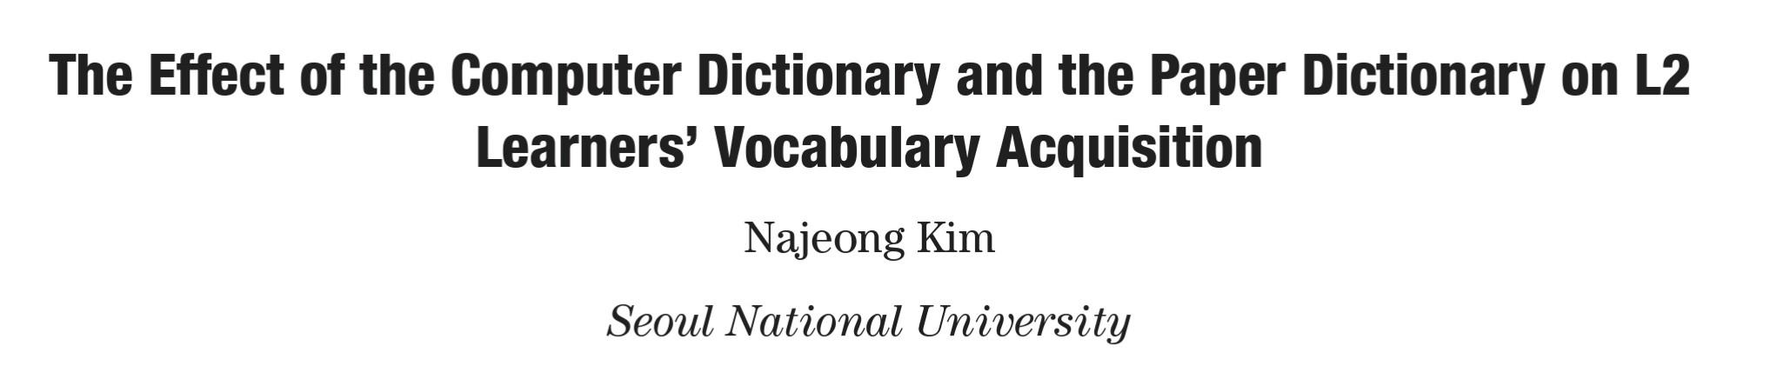
Homework
Read the article for Unit 4

